Slide 1

35 Hours
5 Developers
1 Converter

Slide 2
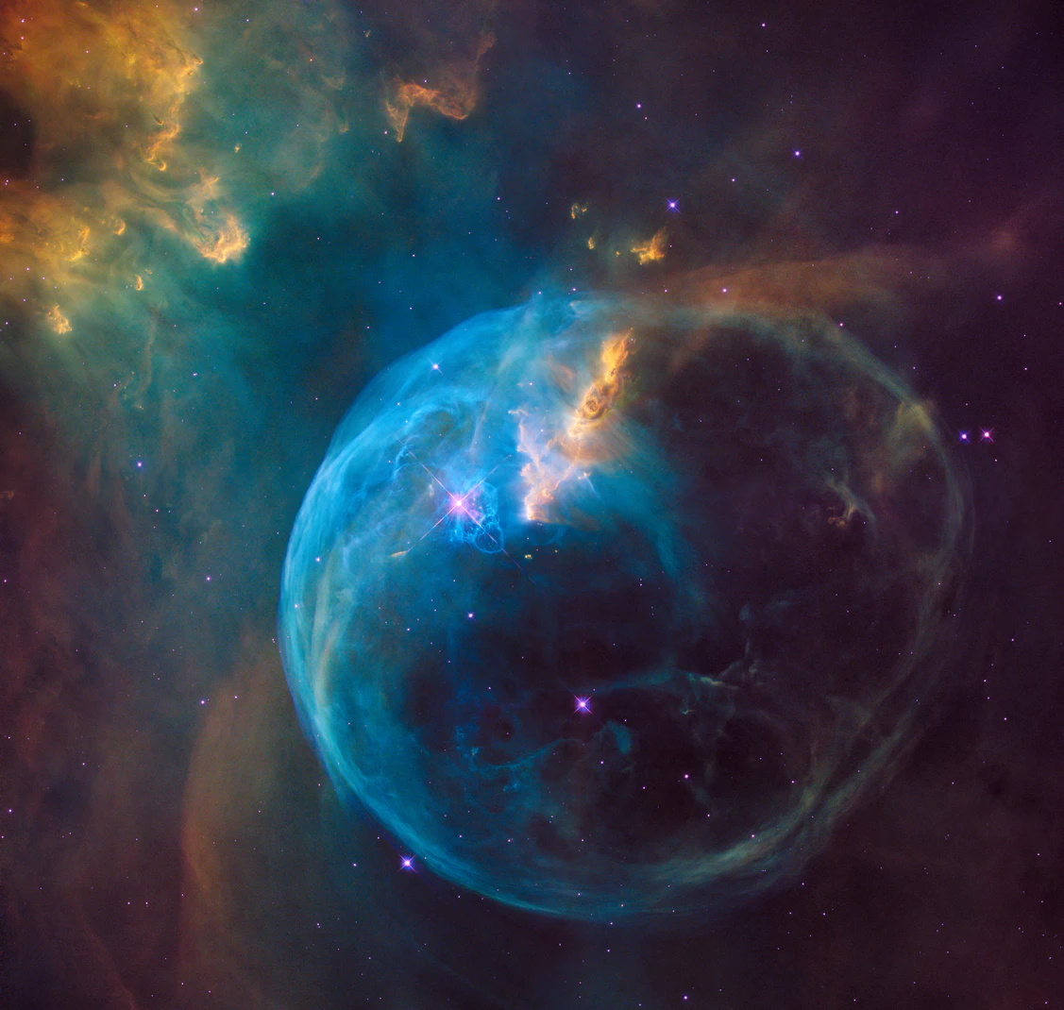
YOUNG&WILD
cosmonauts: Alua D AKBOTa Zh ALINA D DINA K MAGZHAN B

Slide 3
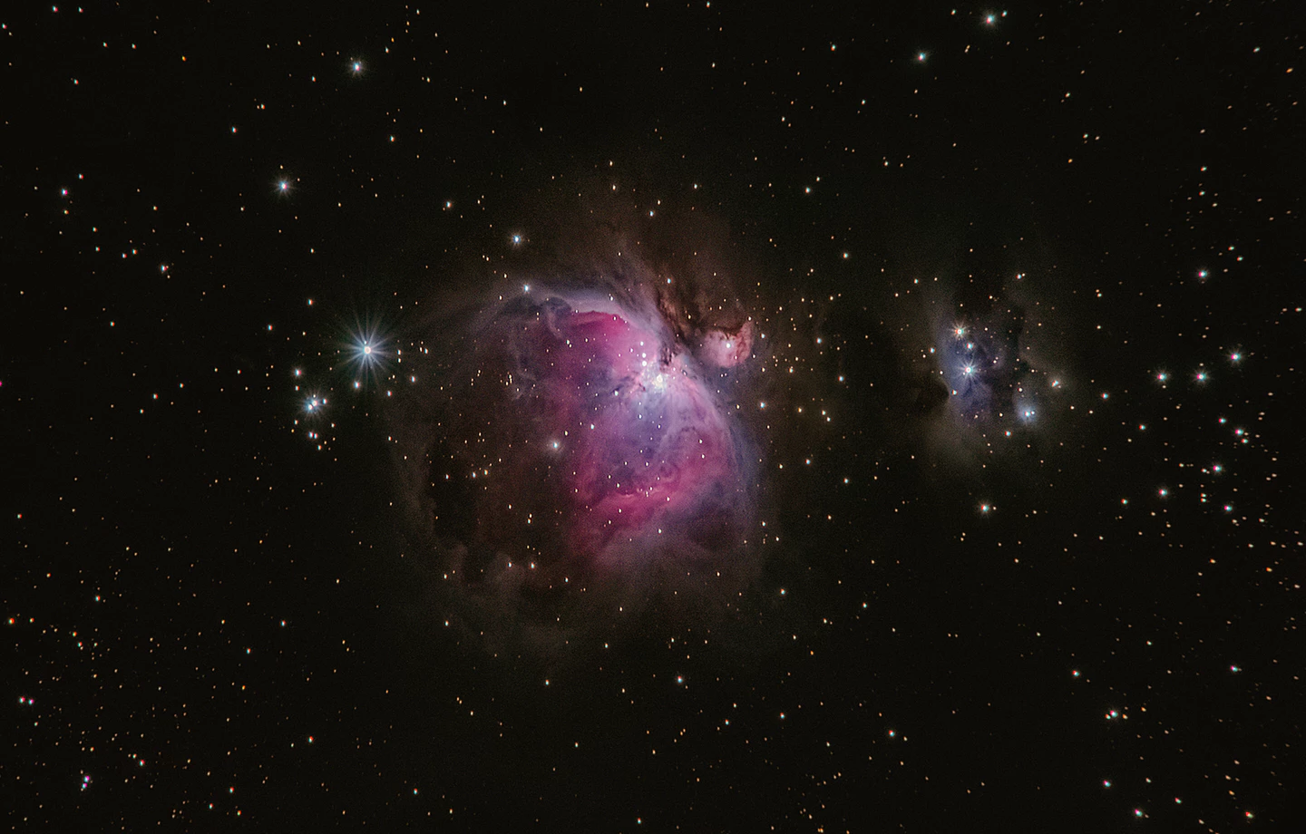
Cosmix
Universal programming language

Slide 4
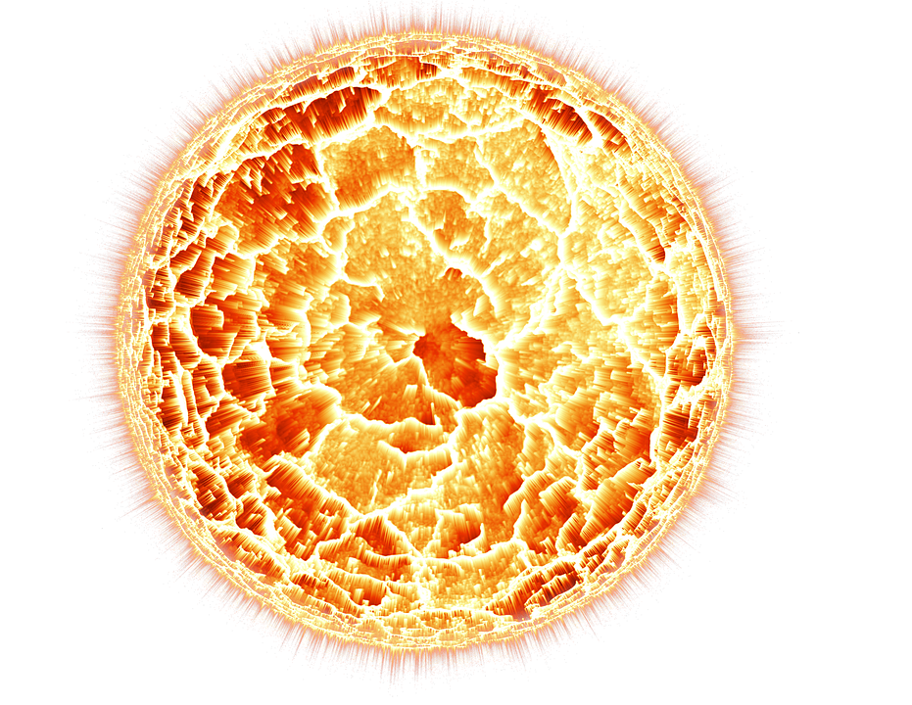

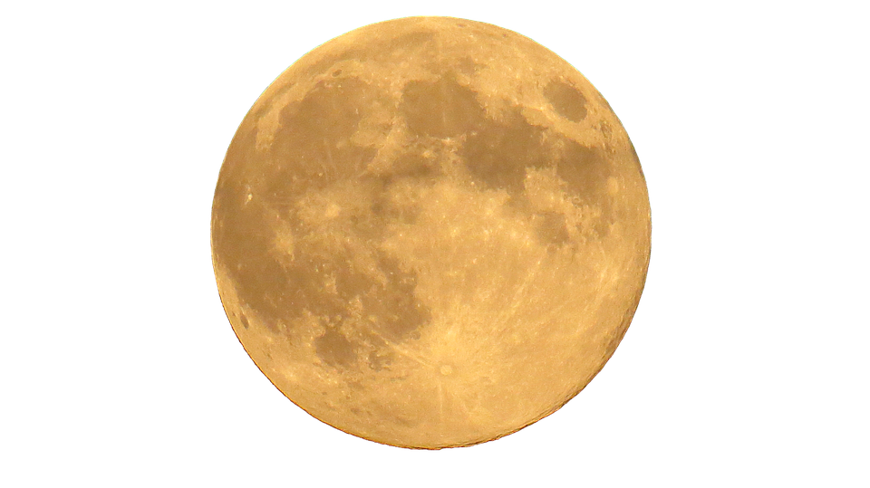
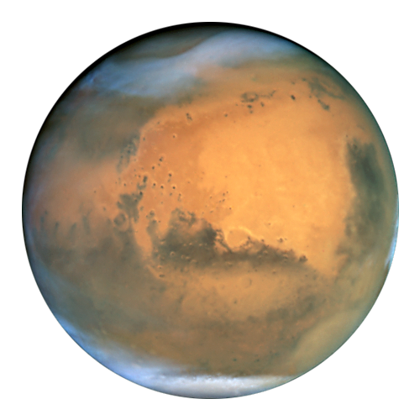
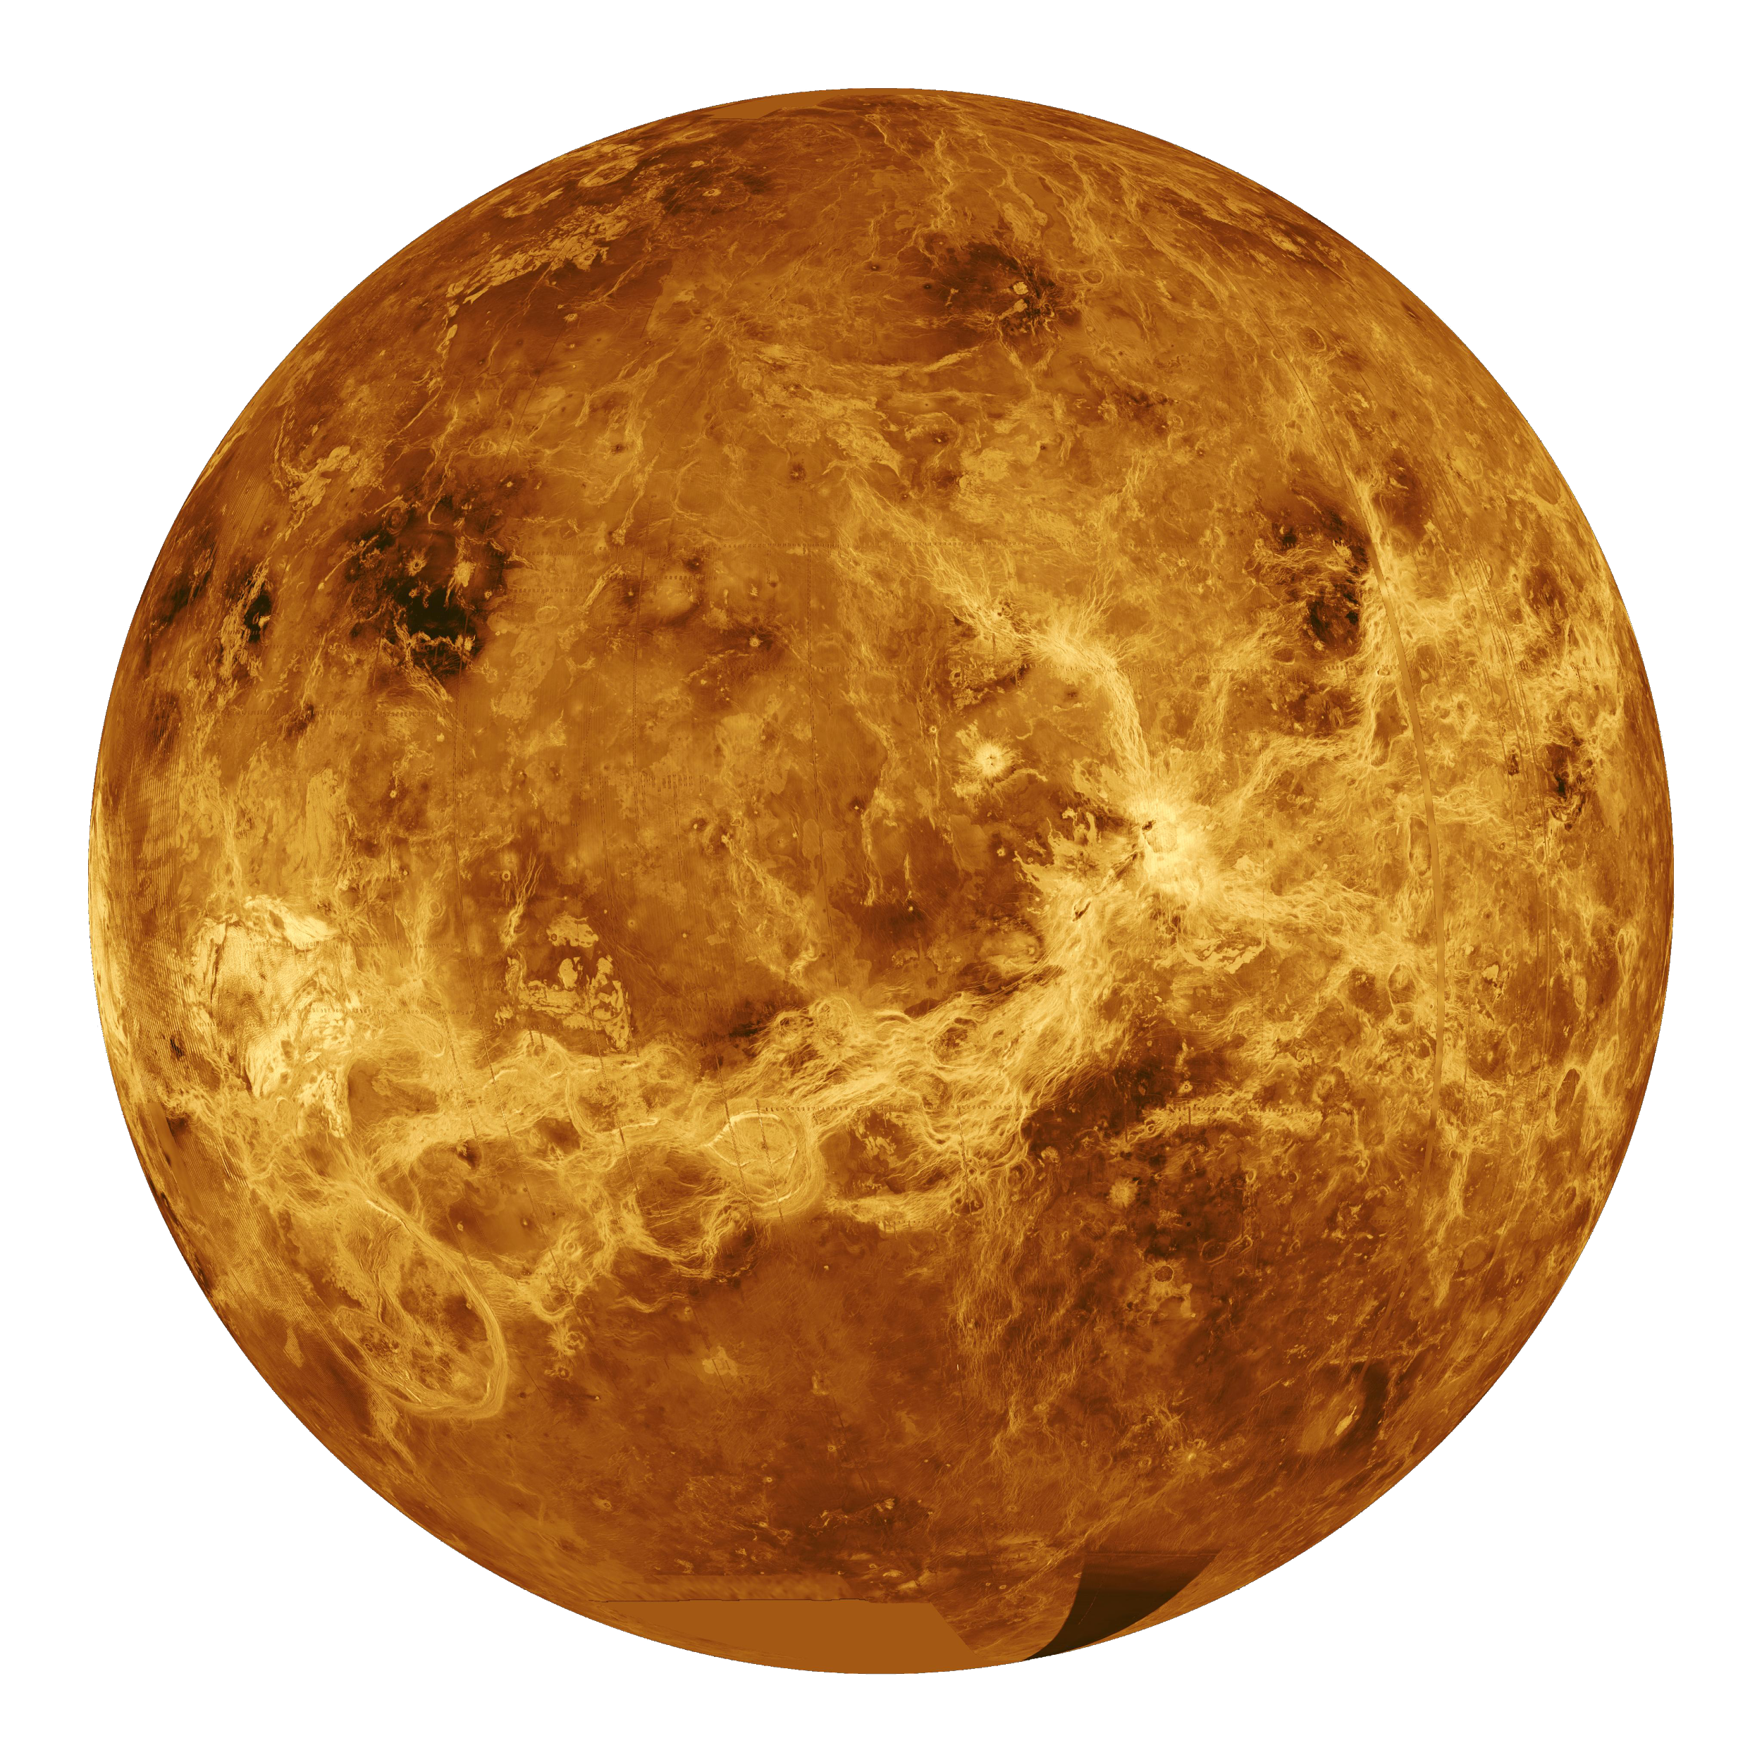
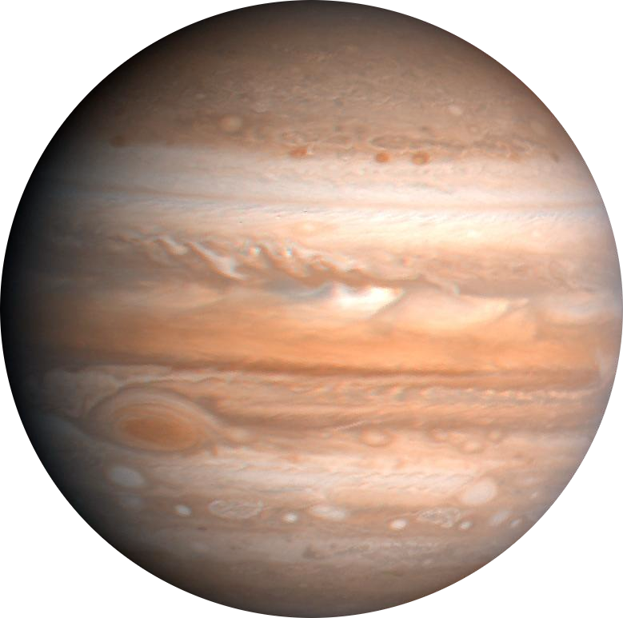
EARTH = 3
SUN = 0
MERCURY = 1
MARS = 4
VENUS = 2
JUPITER = 5

Slide 5


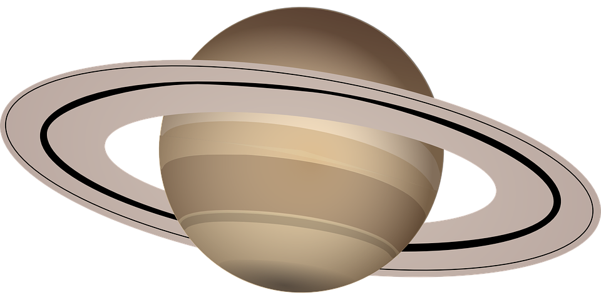
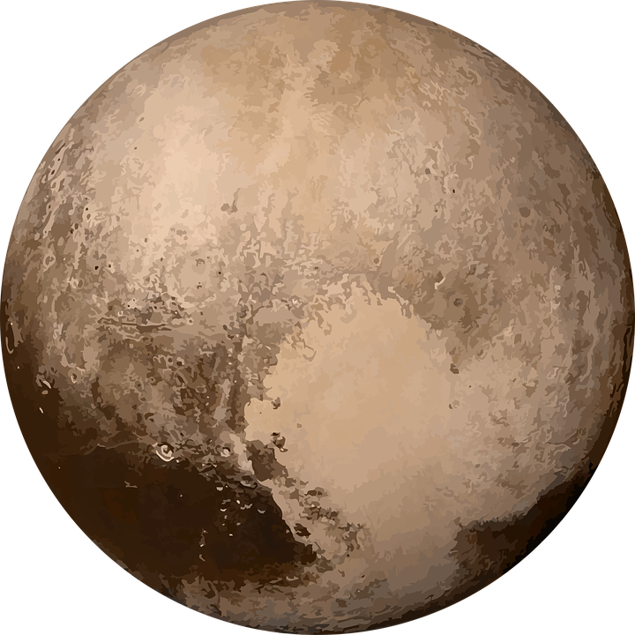
JUPITER = 5
URANUS = 7
NEPTUNE = 8
SATURN = 6
PLUTO = 9

Slide 6

KeyWords
Range §
LandedOn =
TravelUntil <
TravelFurtherThan >
TravelTo ==
NotTravelTo !=

Slide 7

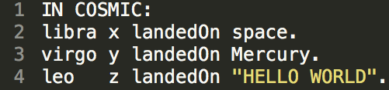
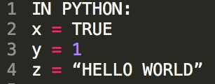
Cosmix Python
Virgo int
Leo string
Libra bool

Slide 8
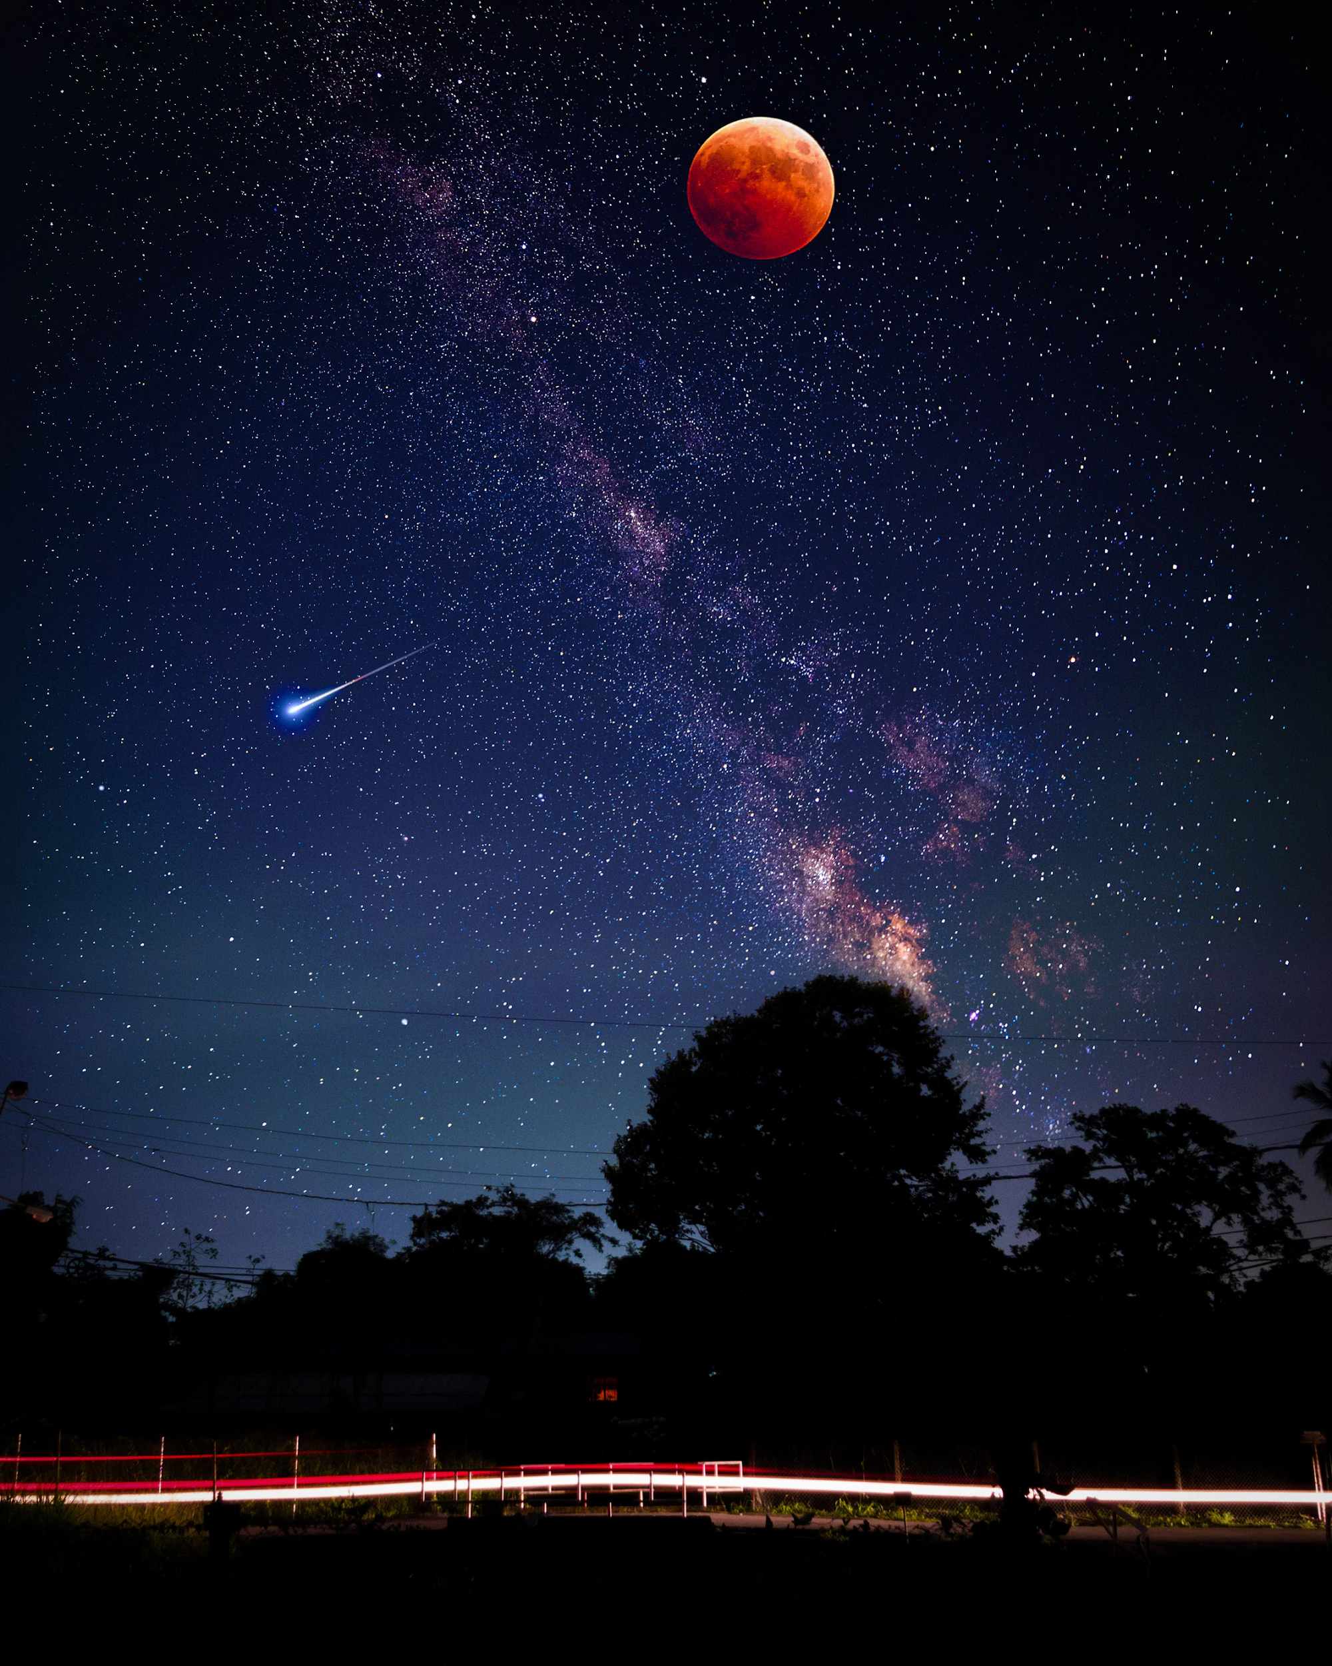
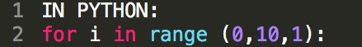
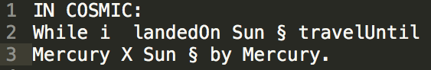
Cosmix Python
while for
when if
butInCase else
blackhole false
space true
say print

Slide 9
Our compiler can be divided into three components:
Lexer Parser Code Generator

Slide 10

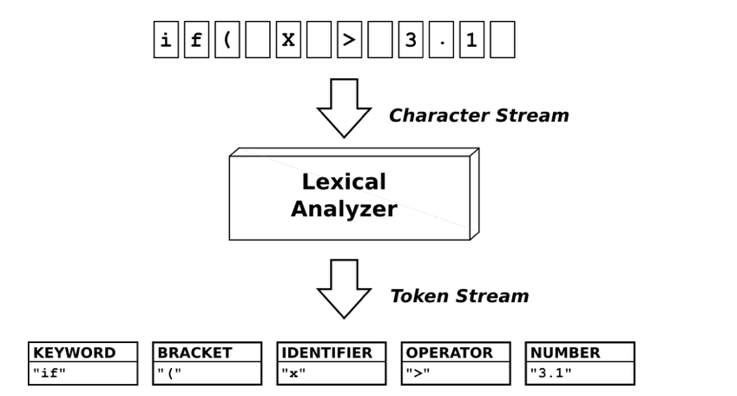
Lexer
The first component of our compiler is the Lexer. It’s role is to take the program as input and divide it into tokens

Slide 11
Parser
The second component in our compiler is the Parser.
It’s role is to do a syntax check of the program.
It takes the list of tokens as input and creates an AST as output.

Slide 12
Code Generator
The third and last component of out compiler .
It’s role is to transform the AST created from the parser into machine language.

Slide 13
